Slide 1
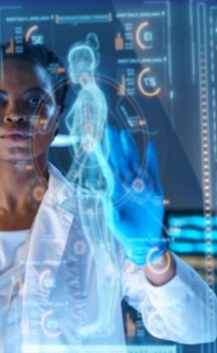

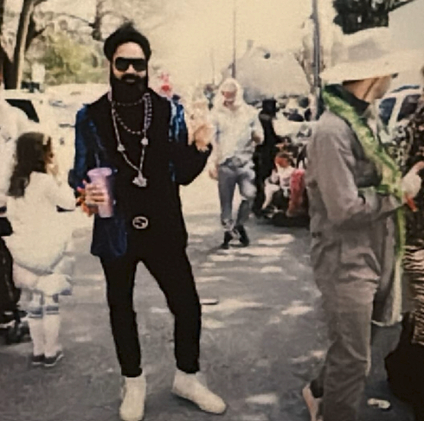




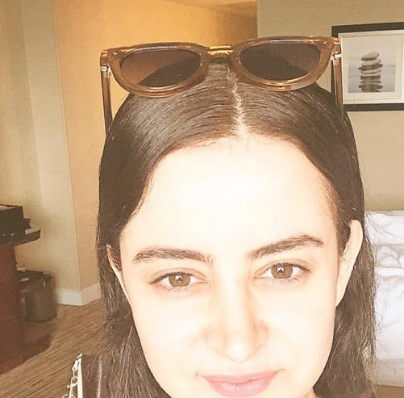
PathoPredictor:
Disease Prediction Using Neural Networks
We’ve harnessed the power of neural network architectures to build, assess, and select the right model to support an app that can accurately identify diseases from given symptoms. This presentation will guide you through our journey, from conception to implementation, detailing data preparation, the logic for model selection, as well as the relevance of this technology in the healthcare arena.
6 Contributors: Andy Bhanderi, J'Mari Hawkins, Peta-Gaye Mckenzie, Priscilla Morales , Kyle Prudente, Funda Subasi
Notes:
Multilayer Perceptron (MLP), Convolutional Neural Network (CNN), Long Short-Term Memory (LSTM) and a transformer model (DistilBERT)—
Peta presents: Slide 1
Python: The primary programming language used.
TensorFlow/Keras: For building and training the neural network models.
Streamlit: To create a user-friendly web application that interacts with the trained models.
Pandas/Numpy: For data manipulation and numerical operations.
Hugging Face: For training the DistilBERT transformer model.
Note: The Streamlit application serves as the interface for users to interact with the MLP model. Users can input their symptoms, and the application will predict potential diseases. The application is designed to be intuitive and accessible for non-technical users.
Alignment to Project Requirements
Leveraged datasets large enough to effectively train a neural network with a high degree of accuracy for reliable results
Evaluated trained model(s) using testing data. Included calculations, metrics, or visualizations used to evaluate performance
Utilized the following:
scikit-learn
Keras
TensorFlow
Hugging Face
Used a library or technology NOT covered in class, specifically: Streamlit

Slide 2

Project Overview
Objective
Develop a neural network model for accurate disease prediction based on input symptoms using a Disease-Symptom dataset.
Importance
Enable accurate disease prediction to improve patient outcomes and reduce healthcare system burden. Targeting healthcare providers as users, particularly in low resource settings.
Dataset
We used a Disease Symptom dataset which combined disease and associated symptom data from the US Chronic Disease Indicators and Diseases and Conditions CDC datasets.
Innovation
Leverage machine learning techniques to create a baseline diagnostic tool within a custom web app that can be iteratively improved over time.
Notes:
Peta presents: slide 2
The dataset for this project was sourced from Kaggle (dataset link) and those data were sourced from the CDC.
Symptom-Disease DataFrame Example: diseases_data = "Common Cold": ["Runny nose", "Sore throat", "Cough", "Fever", "Fatigue", "Sneezing", "Congestion", "Headache", "Mild fever", "Body aches"],

Slide 3
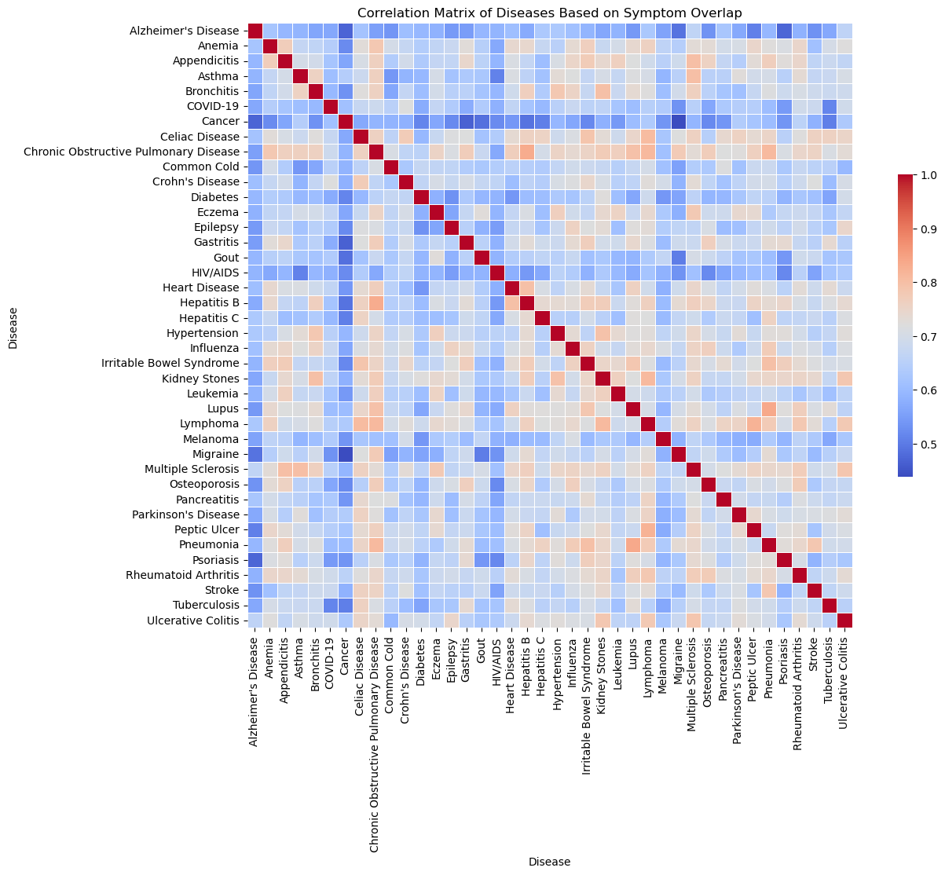
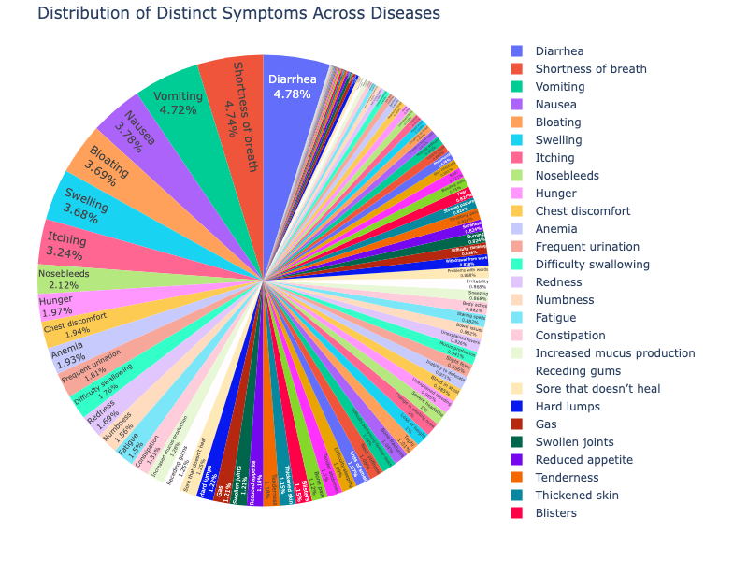
Data Collection & Preparation
1
Data Extraction
We extracted relevant data from the Disease Symptom dataset, focusing on comprehensive disease-symptom relationships among 41 Diseases and 60 weighted symptoms. This process involved careful selection to ensure the data's quality and relevance to our predictive model.
2
Data Preprocessing
Our team engaged in thorough data preprocessing, which included handling missing values through advanced imputation techniques, using weights to prioritize certain symptoms, and encoding categorical variables using methods like one hot encoder.
Notes:
Priscilla presents – Slide 3
Note after making point 1:
F1: Number of overlapping symptoms – light red/symptoms that overlap with other diseases --- blue/no overlap
F2: distribution of symptoms

Slide 4

Model Selection and Architecture
Multi-layered
Perceptron (MLP)
Convolutional
Neural Network
Long Short Term
Memory (LSTM)
Transformer Model
(DistilBERT)
1
2
3
4
TEST ACCURACY | 0.81 | 0.80 | 0.025 | N/A
TEST LOSS | 0.89 | 1.44 | 3.68 | 2.37
MLP was chosen for its robustness in handling tabular data. The model was integrated into the Streamlit for disease prediction.
Though predominantly used for image data, CNNs have been adapted in this project to treat symptom data as one-dimensional spatial vectors, extracting patterns that are essential for disease prediction.
LSTM was utilized considering the sequence in which symptoms are reported could provide significant predictive power.
We also experimented with the distilbert-base-uncased transformer model, trained using Hugging Face over approximately 5 hours.
Notes:
Priscilla presents – Slide 4
Where should these comments fall?
J’Mari: Changed number of neurons per layer, changed batch sizes, found appropriate learning rate.
Based on the results, the Multi-Layer Perceptron (MLP) model performed the best, showing strong accuracy and low loss. The Convolutional Neural Network (CNN) also performed reasonably well but had a slightly higher test loss. The Recurrent Neural Network (RNN) with LSTM and the Transformer Model (DistilBERT):, despite several modifications, did not perform well, indicating that it might not be the right choice for this dataset.
Multi-Layer Perceptron (MLP): The MLP model showed strong performance, with a training accuracy of 100% and a test accuracy of 81%. This indicates that the model was able to learn the patterns in the training data effectively and generalize relatively well to unseen data. The model's loss was also low, making it the best performer among the models tested.
Convolutional Neural Network (CNN): The CNN model performed well with a test accuracy of approximately 80.5%. Although the training accuracy was high, the model experienced a higher loss during testing, suggesting that while it captured some patterns in the data, it wasn't as effective as the MLP in generalizing to new examples.
Recurrent Neural Network (RNN) with LSTM: The LSTM model was modified several times to improve its performance. Despite these modifications, the LSTM performed poorly, with a test accuracy of only 2.25% and a high test loss. This suggests that the LSTM struggled to learn meaningful patterns from the data, likely due to the nature of the dataset, which may not be well-suited for a sequential model like LSTM.
Transformer Model (DistilBERT): We experimented with the distilbert-base-uncased transformer model, trained using Hugging Face over approximately 5 hours. However, this model performed poorly with an evaluation loss of 2.38, which was higher than the neural network models.

Slide 5
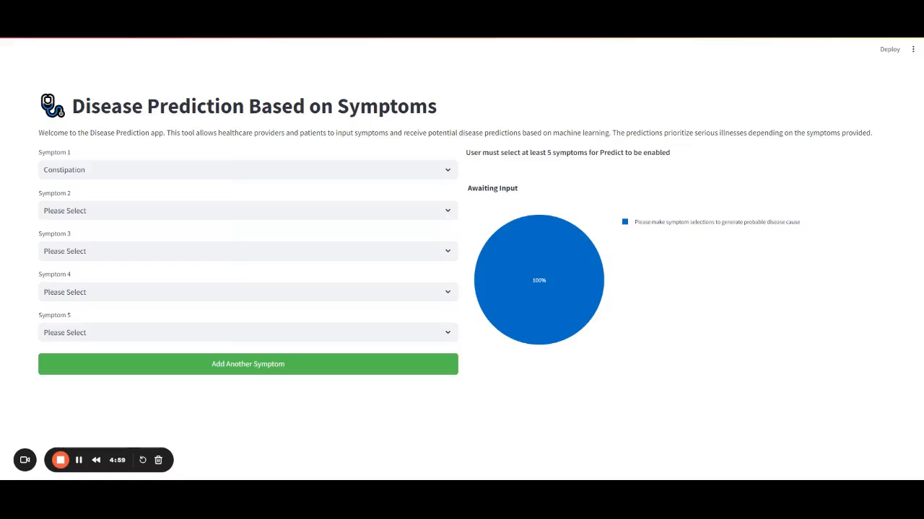



PathoPredictor
App Demo
Notes:
J’Mari’s recorded Loom Demo

Slide 6




Challenges Encountered
Data Quality and Usability
Initial dataset was prone to overfitting; switched to new dataset
Finding new data that could be trained with a deep learning model.
Encode: changing words-to-numbers for corresponding symptoms
Symptom Overlap Challenges
Challenges distinguishing between diseases with overlapping symptoms, particularly in respiratory conditions.
This insight highlights areas where additional data or model refinement may be necessary to improve diagnostic accuracy.
General Troubleshooting
Debugging and resolving issues with App
Notes:
Priscilla presents – Slide 6

Slide 7
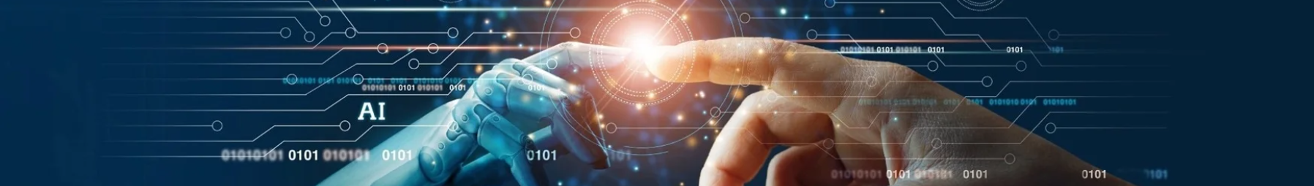
Ethical Considerations and Bias Mitigation
Fairness & Equity
Transparency & Accountability
Privacy Protection
We are committed to ongoing analysis of prediction disparities across different demographic groups to address potential biases in our model .
We have established clear guidelines for the responsible use of our AI system as outlined in our Streamlit app’s medical disclaimer.
In consideration for privacy concerns, we do not request any personal information or self identifying information to protect users of the app.
Notes:
Andy presents: slide 7

Slide 8
Future Considerations
Dataset Expansion
Further Finetuning
Future work will focus on integrating additional datasets from reputable sources like WHO and NIH, enhancing the model's robustness and generalization across a wider range of diseases and patient populations. Model would also benefit from specialized datasets for better diagnosis for rare diseases
Future milestones are to 1) incorporate feature importance analysis to identify certain symptoms that are less predictive, and 2) with patient permission, use their anonymized data to finetune the model for better predictive accuracy.
1
2
3
Medical History Integration
An important next step is to begin to take into account patient medical history including family history, past blood work, past diagnosis etc. to facilitate more accurate results.
Notes:
Andy presents: slide 8

Slide 9
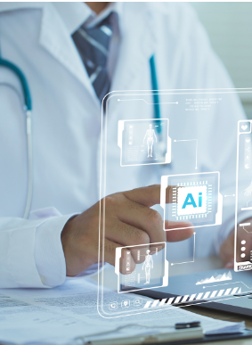
LET’S CHAT
6 Contributors: Andy Bhanderi, J'Mari Hawkins, Peta-Gaye Mckenzie, Priscilla Morales , Kyle Prudente, Funda Subasi

